Slide 1
Mapping of
Gender & Corona Response Measures
KC Rule of Law, Gender, Security I Division Governance and Conflict I Sectoral Department
|June 2020

Slide 2
Platzhalter Weltkarte mit Übersicht
(Projekt + Überschrift)

Slide 3
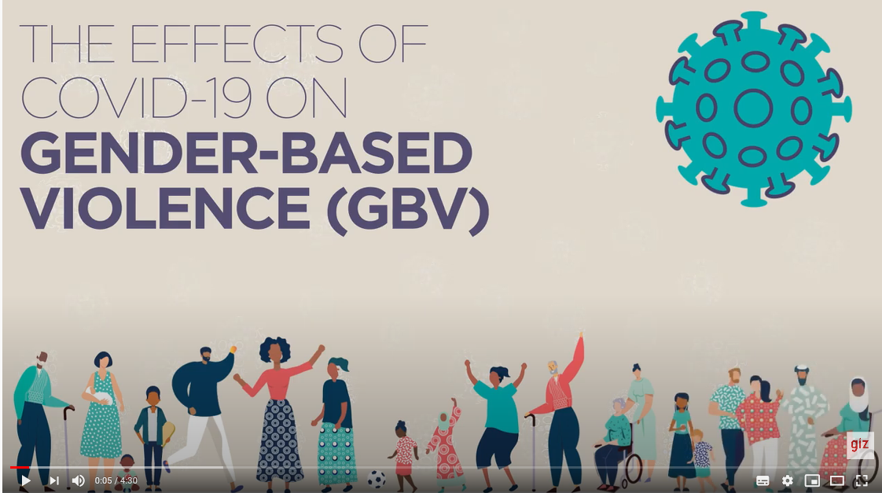
AWARENESS RAISING – VIDEO ON COVID-19 & GBV
The video provides information on the link between COVID-19 and GBV and the important role governments, civil society, media, private sector companies and development partners can play to address GBV. In addition, it informs women and children who are at risk of experiencing GBV, or who have already experienced it, about where to seek information or services. This includes a list of helplines from 16 SADC member states in Southern Africa. Seeking services can reduce the consequences of violence on the well-being, health and safety of women and children.
This video has been produced by the GIZ programme Partnerships for Prevention of Violence against Women and Girls in Southern Africa (PfP) in collaboration with the Gender Unit of the Southern African Development Community (SADC).
Further information on PfP: www.partnershipsforprevention.org.
English version
French version (anglais avec sous-titres français)
Portuguese version (Inglês com legendas em português)

Slide 4
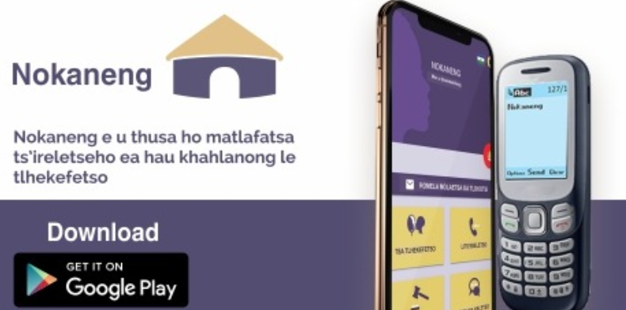
AWARENESS RAISING – NOKANENG APP
The ‘Nokaneng’-flagship initiative of the GIZ program Partnerships for Prevention of Violence against Women and Girls in Southern Africa (PfP) seeks to sensitize women, stimulate conversations and build solidarity in Lesotho.
One component of the initiative is the Nokaneng app a digital/mobile solution consisting of a smartphone application. The app provides information on GBV, rights for women and girls, available services for survivors, and a forum for exchange and peer support.
A complementary SMS-based component reaches out to women and girls without access to the internet and smartphones
In response to the COVID-19-pandemic, information on the virus and Corona-response measures are integrated into the app.
Further information on PfP:
www.partnershipsforprevention.org.

Slide 5
AWARENESS RAISING – RADIO & LISTENER’S GROUPS
The project Promoting peace and stability in Eastern Congo (ProPaix) supports a local partner organisation AFEM (Association des Femmes des Médias) to implement different radio formats, including for instance a text message/SMS-based services and listener’s groups, to provide an alternative space for women to receive information, exchange and communicate on COVID-19. Their community-focused approach is especially addressed to women and girls to sensitive and raise awareness of the pandemic.
Increasingly AFEM also aims to use other media, such as social media, videos and music to address the different risks that the COVID-19 poses (besides health risks also economic and social risks) and prevent the spreading of false rumours about the pandemic.

Slide 6
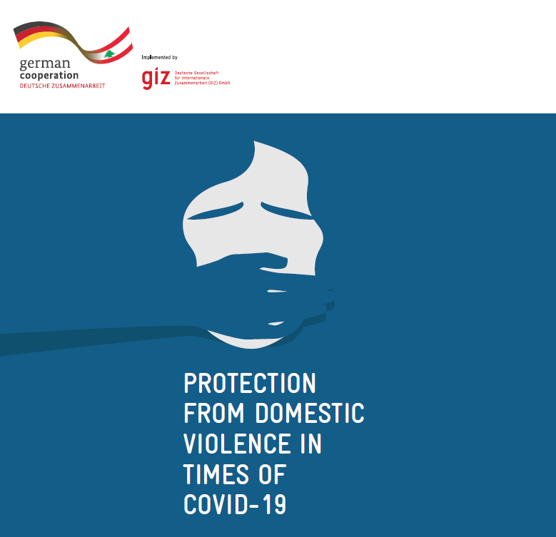
AWARENESS RAISING – INFORMATION LEAFLET
GIZ Lebanon has created a leaflet for women at risk of SGBV, especially domestic violence. It features contact details of government and NGO helplines, including a hotline for LGBTIQ+.
The GIZ program Strengthening women in decision-making in the Middle East (LEAD) teaches female multipliers in Lebanon together with the Red Cross to raise awareness and educate other women in local communities on a range of different topics, including the COVID-19.

Slide 7
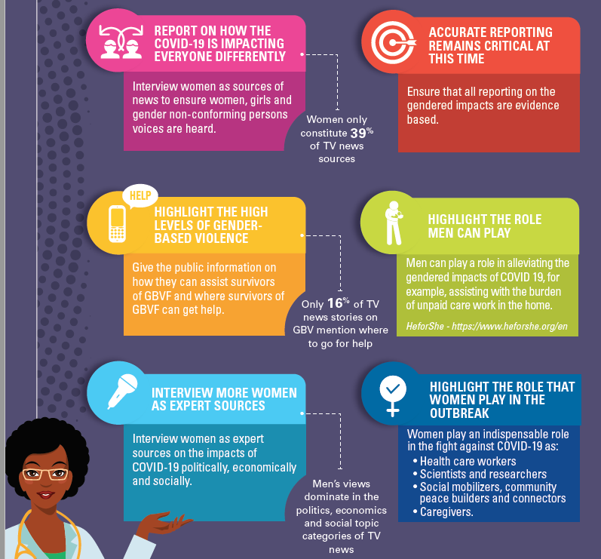
MEDIA - GENDER AWARE REPORTING ON COVID-19
The GIZ programme Partnerships for Prevention of Violence against Women and Girls in Southern Africa (PfP) in collaboration with UN Women has produced a Reporting Guideline on the Gendered Impacts of COVID-19. It provides information on the gender-aware reporting of COVID-19, including an overview of the gendered impacts of COVID-19 as well as suggestions of how journalists can report in a gender-sensitive manner.
Further information on PfP: www.partnershipsforprevention.org.

Slide 8
ECONOMIC EMPOWERMENT & MENTAL HEALTH SUPPORT
Additionally, the women can also access mental health counselling through qualified psychologists, psychotherapists and well-trained volunteers. Since its inception, 131 incoming calls were registered and 90 women entrepreneurs received guidance.
The Project Economic Empowerment of Women Entrepreneurs and Start-ups by Women in India (Her&Now) has launched WE Talk!, a toll-free helpline to support women entrepreneurs from the North Eastern Region who are affected by the COVID-19 pandemic.
The helpline supports entrepreneurs to access business resources and provide information regarding schemes, loans and other financial assistance that are available in the market.
Further information on https://herandnow.in/
Additionally, the support programs for women-led companies were extended with a special focus on capacity development measures to adapt business models and especially marketing strategies to the changed market situation of the COVID-19 pandemic, as well as support in applying for government grants and subsidies

